Slide 1



Development of master curricula for natural disasters risk management in
Western Balkan countries
NatRisk
WP-6: Dissemination
Dejan Rančić
University of Niš, Faculty of Electronic Engineering
Kick-off meeting / 15th and 16th December 2016.
Project number: 573806-EPP-1-2016-1-RS-EPPKA2-CBHE-JP
"This project has been funded with support from the European Commission. This publication reflects the views only of the author, and the Commission cannot be held responsible for any use which may be made of the information contained therein"

Slide 2
What is Dissemination?
Development of master curricula for natural disasters risk management in Western Balkan countries
In terms of Erasmus+ programme dissemination means spreading the word about project successes and outcomes as far as possible.

Slide 3
Objectives
Development of master curricula for natural disasters risk management in Western Balkan countries
The main objective of project dissemination and exploitation is to maximize the impact of the project by developing public awareness, optimizing the values of project results, strengthening their impact, transferring them to different contexts, integrating them in a sustainable way and using them actively in systems and practices in local and international levels.
The second goal is to contribute to the implementation and shaping of national and European policies and systems.

Slide 4
Related assumptions and risks
Development of master curricula for natural disasters risk management in Western Balkan countries
Assumptions:
Motivation and competences of all members of the consortium.
The interest of society, government bodies, students and non-partner HEIs in the project
Media support to project dissemination activities.
Risks:
Not properly planned dissemination activities.
Poorly selected target groups.

Slide 5
Description
Development of master curricula for natural disasters risk management in Western Balkan countries
Project dissemination will involve institutional, national and international activities. It will be focused on promotion the project and its participants and to raise awareness of the public about the potential benefits of the project results. One of the first tasks in this WP is creation of the project website, which will present all activities related to the project. Special attention will be devoted to the promotion of the project on social networks such as Facebook, LinkedIn and Twitter. The awareness campaign will include advertising on TV, radio and newspapers.

Slide 6
Description
Development of master curricula for natural disasters risk management in Western Balkan countries
Special attention will be paid to promoting new master curricula in WB HEIs and developed educational trainings for citizens and public sector. It will be organized promotions for WB non-partner HEIs in order to promote master studies in the field of risk management of natural disasters. Promotions in HEIs will perform teachers and students. All events will be documented and displayed on the project website.

Slide 7
Description
Development of master curricula for natural disasters risk management in Western Balkan countries
Dissemination of the project outcomes will be carried out also through the postgraduate NatRisk WeB students, well educated in risk management of natural disasters.
In the long term perspective of the NatRisk WeB project it is necessary to increase the public and state authorities’ awareness for the significance of the management of natural disasters. This goal will be achieved mainly through the distribution of brochures, leaflets and booklets aimed to provide all relevant project information to interested stakeholders, as well as to publish information about NatRisk WeB in mass media.

Slide 8
Tasks
Development of master curricula for natural disasters risk management in Western Balkan countries
Creation of dissemination plan.
Development, design and maintenance of the project website
Organization of marketing and PR activities, design, publishing and distribution of promotional materials.
Organization of project promotion at public events (conferences and meetings).
Organization of promotions for non-partner WB HEIs.

Slide 9
Dissemination plan
Development of master curricula for natural disasters risk management in Western Balkan countries
Dissemination plan will be created at the beginning of the project and will include the following key elements: purpose, audience, message, methods and timing. It will identify and organise the activities to be performed in order to promote the exploitation of the project’s results and the widest dissemination of knowledge of the project. It will be planned in consultation with the project partners and approved by the Steering Committee.

Slide 10
Visual identity
Development of master curricula for natural disasters risk management in Western Balkan countries
Official language
Project Logo
Project web site
Social network profile
Promotion material

Slide 11
Official language
Development of master curricula for natural disasters risk management in Western Balkan countries
Official language is English

Slide 12




Project logo
Development of master curricula for natural disasters risk management in Western Balkan countries

Slide 13
Project web site
Development of master curricula for natural disasters risk management in Western Balkan countries
Project web site is already created and can be accessed at:
www.natrisk.ni.ac.rs

Slide 14
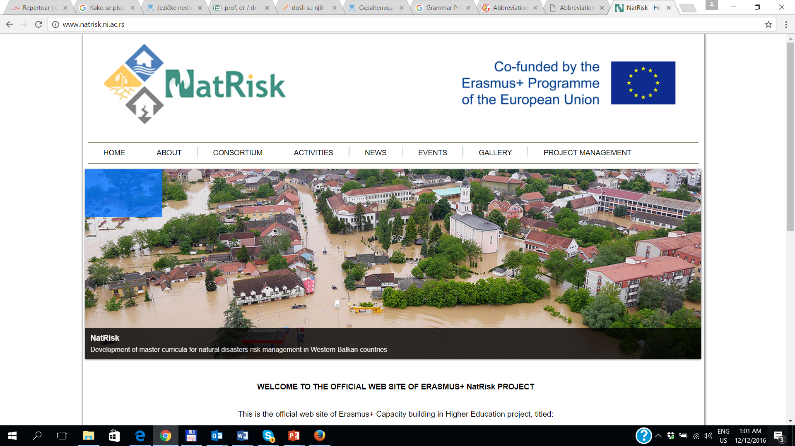
Project web site
Development of master curricula for natural disasters risk management in Western Balkan countries

Slide 15
EU web site for dissemination
Development of master curricula for natural disasters risk management in Western Balkan countries
http://ec.europa.eu/programmes/erasmus-plus/projects/eplus-project-details-page/?nodeRef=workspace://SpacesStore/c3a0d5cf-9f44-40b1-8731-23c187fc13ee

Slide 16
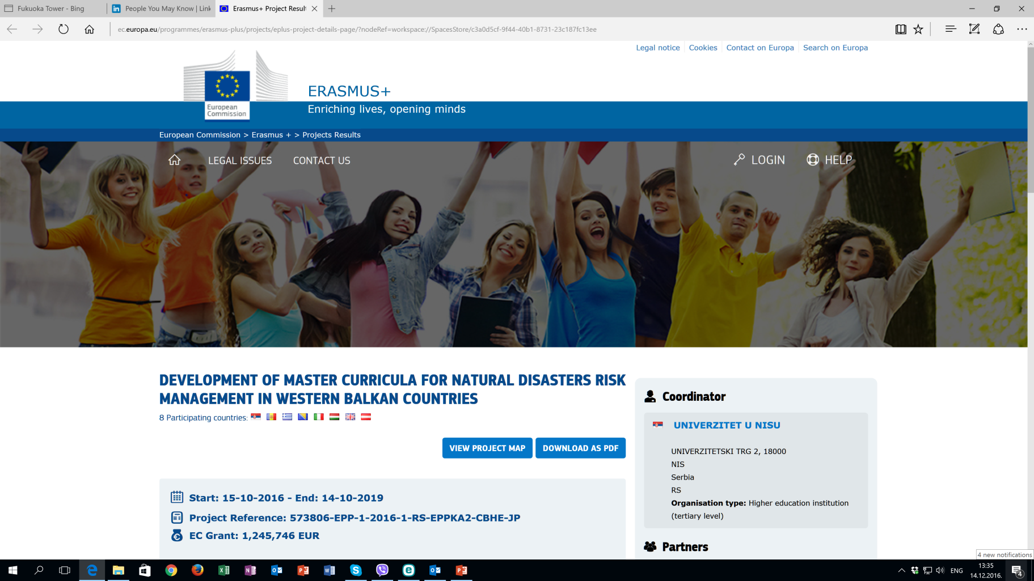
EU web site for dissemination
Development of master curricula for natural disasters risk management in Western Balkan countries

Slide 17
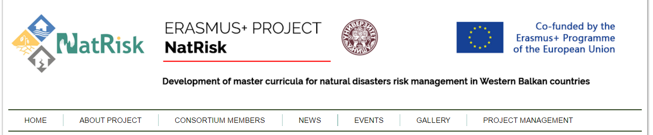
How to access to Project Management Platform?
Development of master curricula for natural disasters risk management in Western Balkan countries
natrisk.ni.ac.rs

Slide 18
Social network profile - FB
Development of master curricula for natural disasters risk management in Western Balkan countries

Slide 19
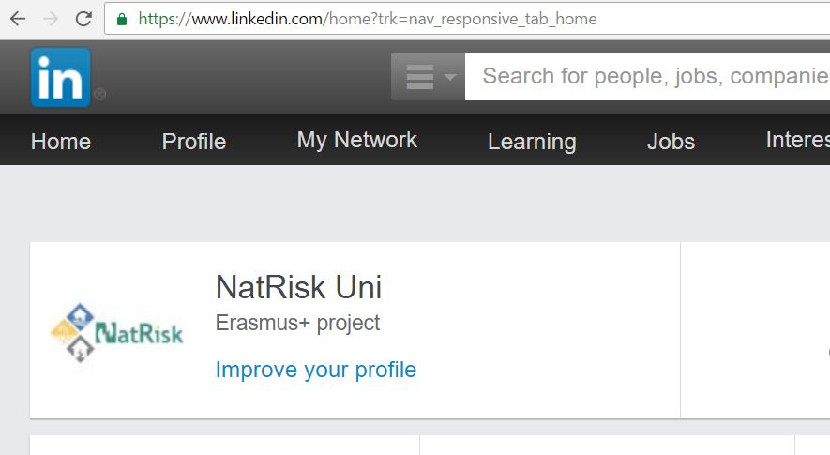
Social network profile - LinkedIn
Development of master curricula for natural disasters risk management in Western Balkan countries

Slide 20




Promotion materials
Development of master curricula for natural disasters risk management in Western Balkan countries

Slide 21
Thanks for your attention!!!
Development of master curricula for natural disasters risk management in Western Balkan countries

